Slide 1



Binary Beats Predicting Morse
code gaps with ML
Prof. Dr. Eugene Pinsky
MET CS 677
Data Science With Python
Presented by Urja Damodhar

Slide 2


Table of Contents
01
Intro to Morse
02
Problem Statement
03
Data set Creation
04
Classification models
05
Sequential models
06
Analysis
07
Conclusion
02/08

Slide 3
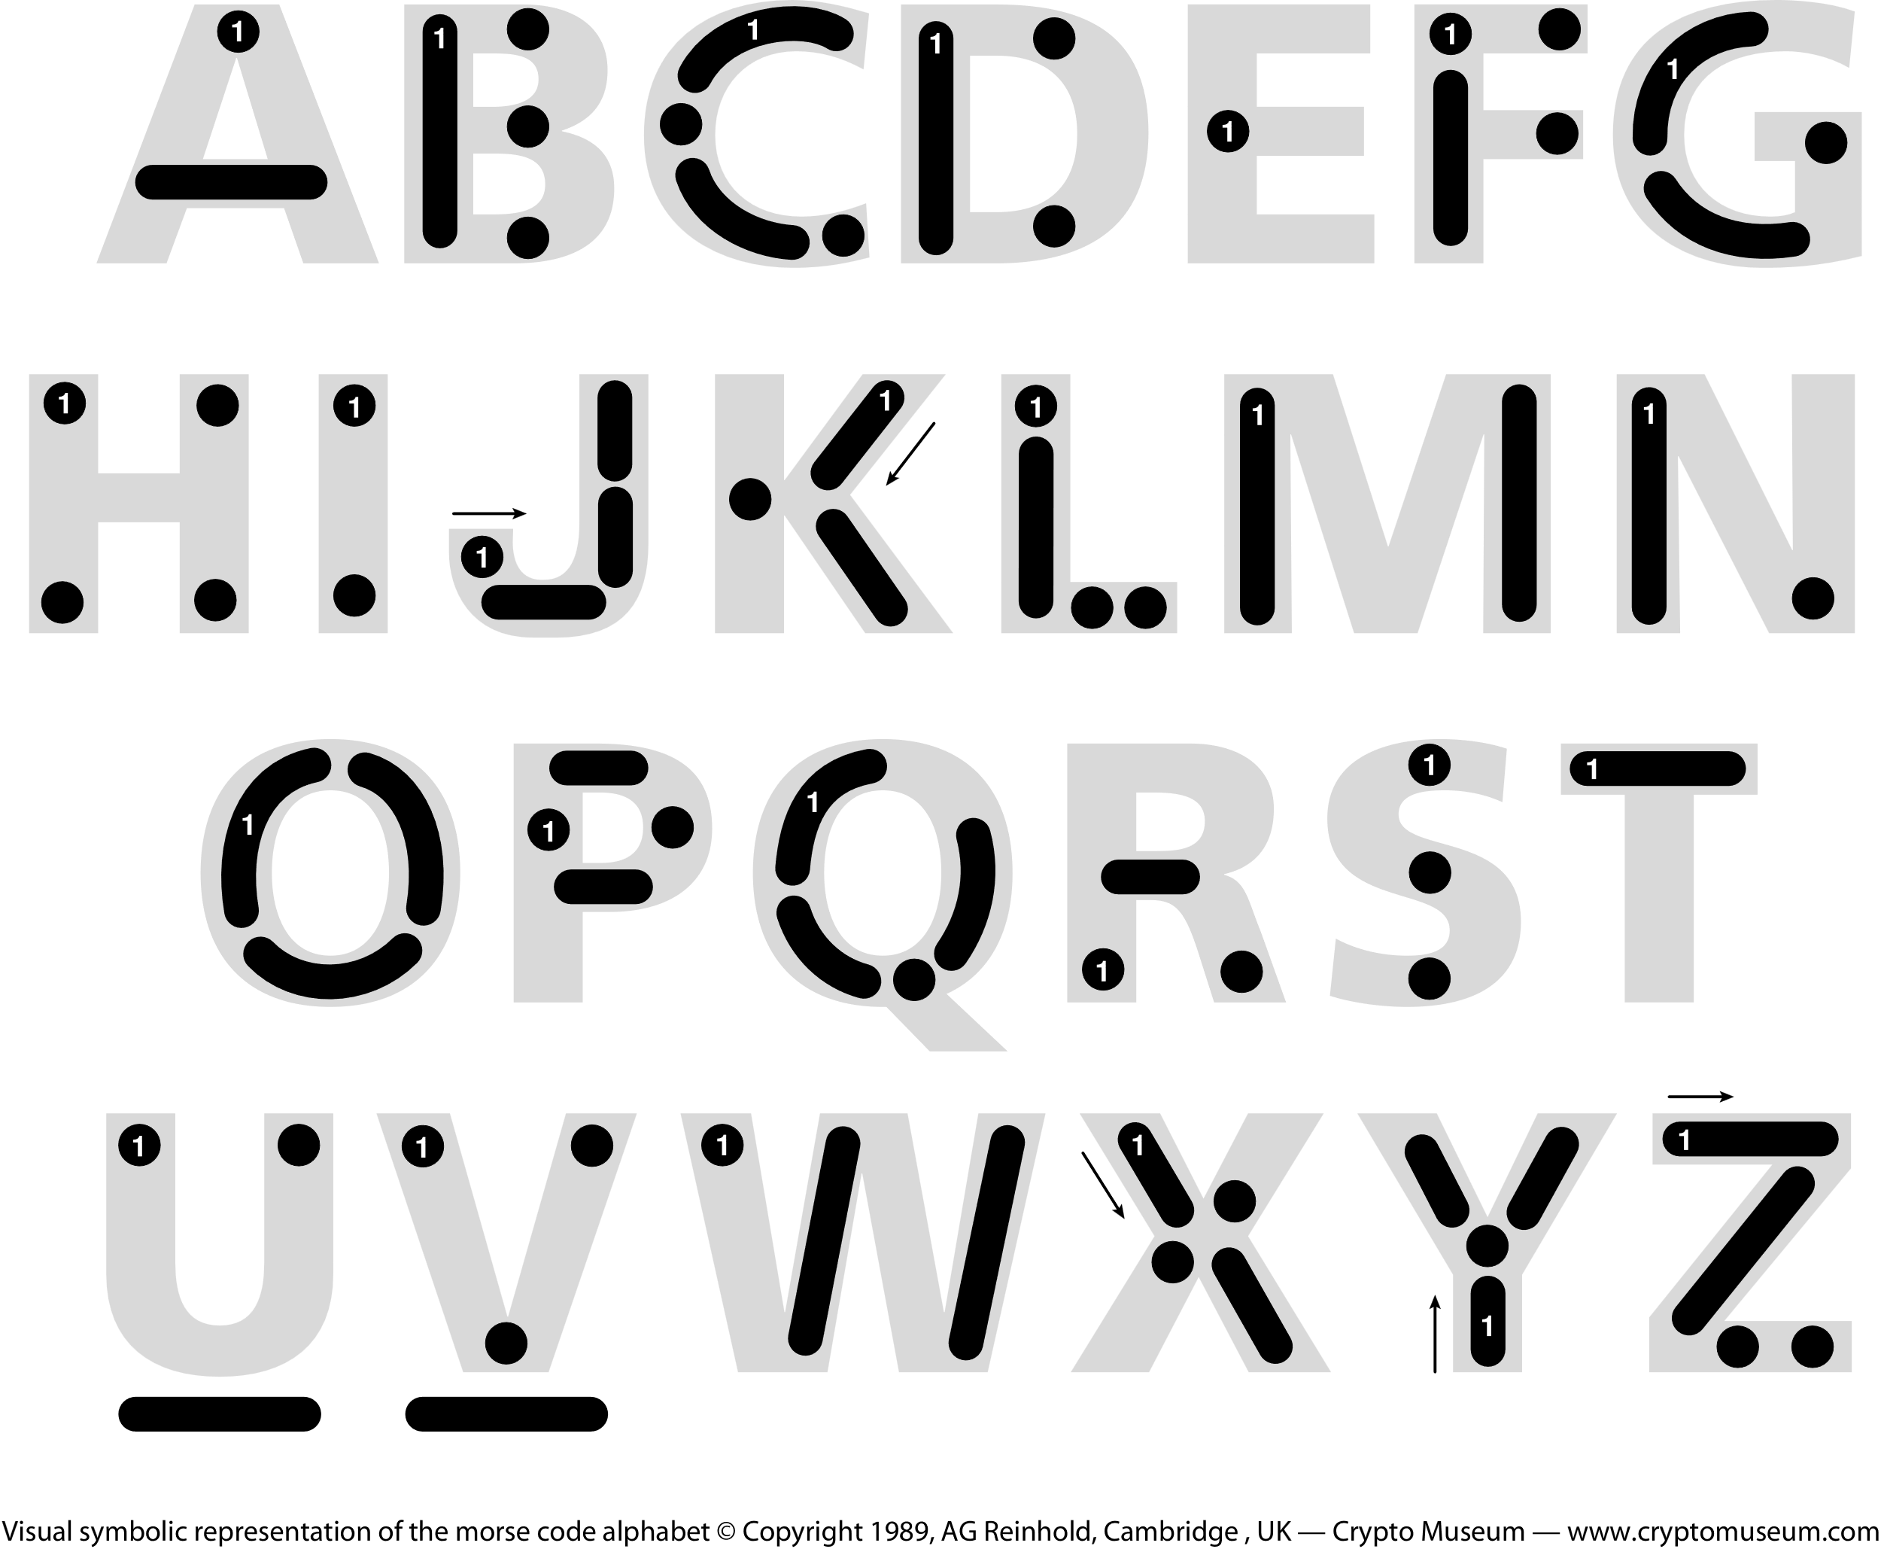
Intro to Morse Code
.. -. - .-. --- - --- -- --- .-. ... . -.-. --- -.. .
Morse Code is a code for translating letters to dots • and dashes —.
These represent a short and long signal duration.
The common distress signal “SOS” doesn’t stand for anything, instead it was chosen as it is easy to transmit.
••• — — — •••
03/08

Slide 4

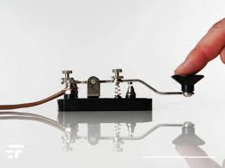
Problem Statement
.--. .-. --- -... .- -- ... - .- -- .- -- . -. -
A predictive model that fills in missing symbols in Morse code sequences. Use machine learning to decode gaps, connecting dots for clear communication in the digital era
04/08

Slide 5


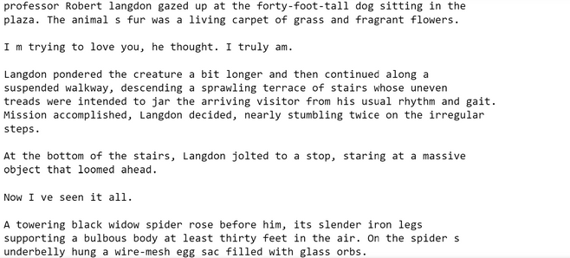



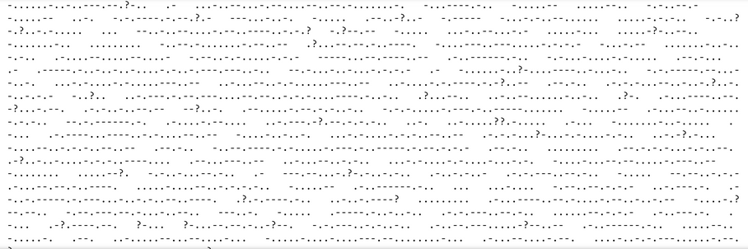
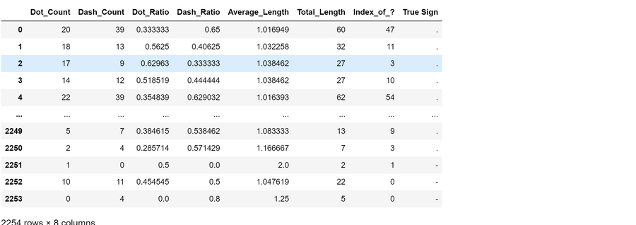
Dataset Creation
-.. .- ... - . ... - -.-. .-. .- ... .. --- -.
Uploaded a text file file and cleanedthe data using regular expression
.--.-
Converting the Text to morse code
-.. .- ... - . ... - -.-. .-. .- ... .. --- -.
corrupting the data by 1%, 2%, and 5% for sequential model
Creating a dataset for classification model
05/08

Slide 6
Models Used
-- --- -.. . - .-.. ..- ... . -..
Sliding Window
Technique
Long Short -Term
Memory
Decision Tree
Logistic Regression
Accuracy : 0.63
Window_size = 2
Accuracy: 0.69
Accuracy: 0.60
Accuracy: 0.64
06/08

Slide 7

Analysis
Decision Tree worked the best in the model compared to others.
Almost all the models were better at predicting dashes except for logistic regression
Future Work
Eye blinking in Morse code can aid communication for ALS patients, offering an alternative method when traditional speech or signing is impaired.
07/08

Slide 8

Thank You
- .... .- -. -.- -.-- --- ..-
08/08

